Slide 1
Registration Errors

Slide 2
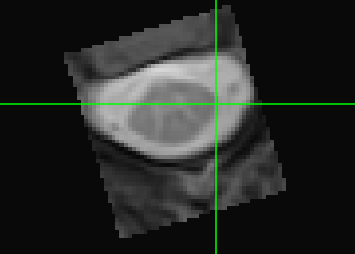
Rotation
Registered mFFE
Template mFFE

Slide 3
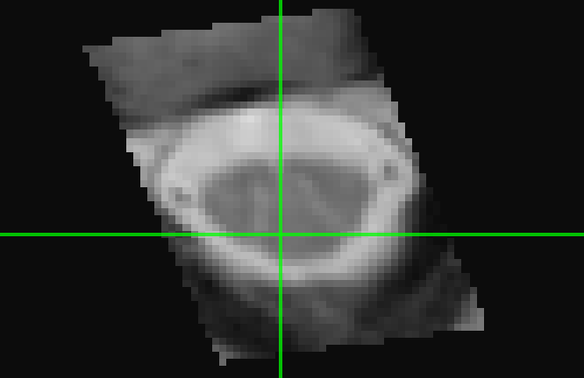
Misalignment
Registered WM doesn’t align with template WM
Registered mFFE
Template mFFE

Slide 4
Compressed Registration
Registered mFFE
Template mFFE

Slide 5
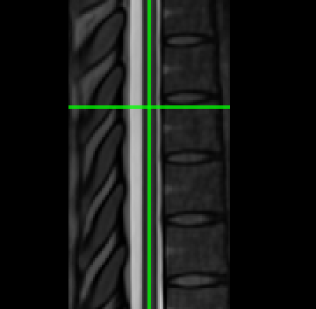
Not Registered
Not showing up in the template space. Tried modifying viewingsettings in fsleyes and still didn’t show up.
Registered mFFE
Template mFFE

Slide 6
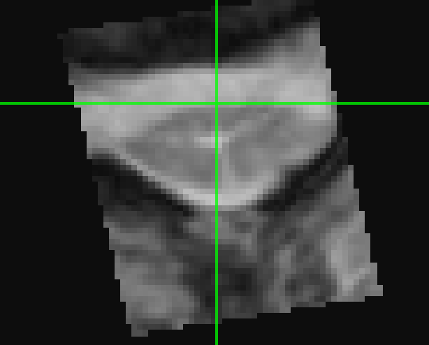
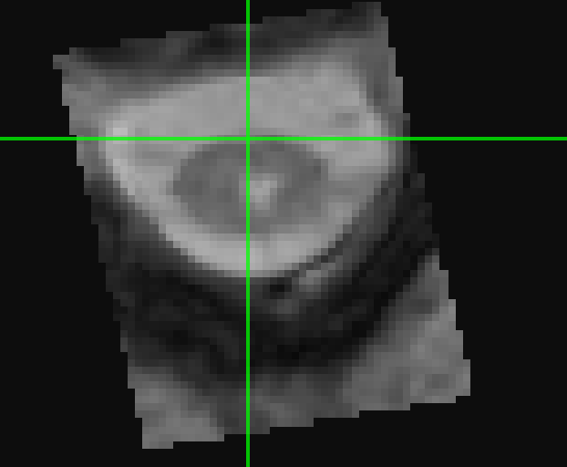
Rotated and becomes Aligned
Superior
Medial
Inferior
Registered mFFE
Template mFFE

